Slide 1
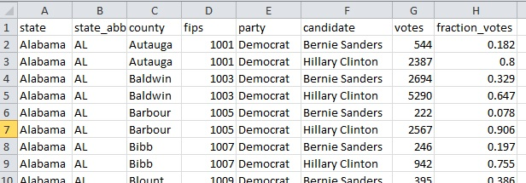
Analyzing US 2016 Primary Election Data
Data Source: Kaggle website (https://www.kaggle.com/benhamner/2016-us-election)
Tables:
Primary results by county (24,611 rows, 8 columns). Table contains number and percentage of votes in each US county for Democratic and Republican candidates in 2016 Primary Elections.
County facts (3,95 rows, 54 columns). Tables contains country characteristics for each country in the United States. Characteristics include but not limited to: total population, age distribution, racial distribution, homeownership rate, languages spoken, median household income, etc.

Slide 2
Examples of Data Exploration Ideas
What candidates within the Republican party have results that are the most anti-correlated?
Can we see clusters of countries/ states (on a map) that have similar results?
What country characteristics correlate with % of Democratic votes that were cast for Bernie Sanders?
What counties characteristics are highly correlated with each other? (for example, is there a correlation between % white and median household ratio?)

Slide 3
Examples of Data Modeling Ideas
Use KNN algorithm to cluster counties into Hilary vs Bernie (2 clusters). Repeat the same exercise for Republican vs Democrat. What county characteristics describe each cluster?
Divide the counties (randomly) to two sets: a training set and a testing set. Train a logistic regression model (using county characteristics) that can predict which county will vote for Hillary Clinton vs Bernie Sanders. Test the model on the testing dataset.

